Slide 1
Query Based Video Summarization Using Attention
Supervisor: Dr Muhammad Rafi

Slide 2
Team Members
Alishba Subhani (20K-0351)
Mannahil Miftah (20K-0234)
Muhammad Umer (20K-0427)

Slide 3
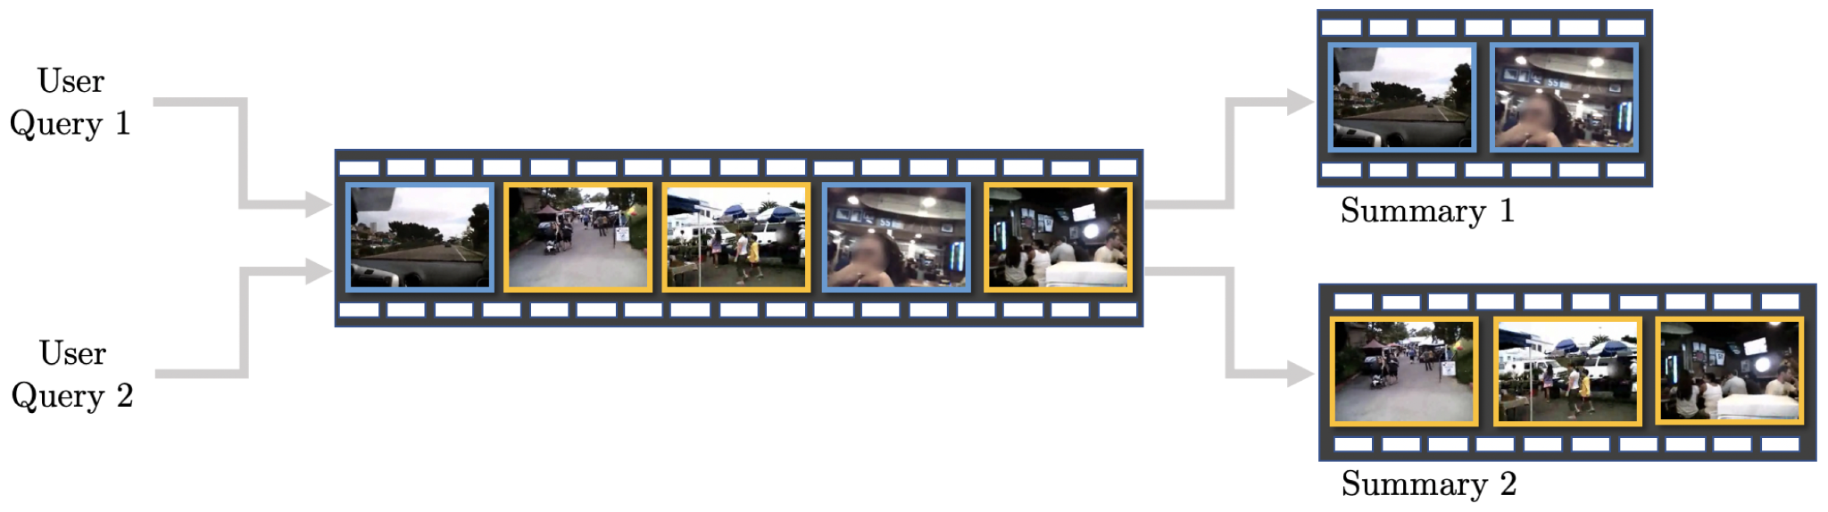
PROJECT DEFINITION
This project aims to create an end-to-end attention based deep learning solution for a query based video summarization, where the system automatically generates concise yet informative summary of input video relevant to the input query.

Slide 4

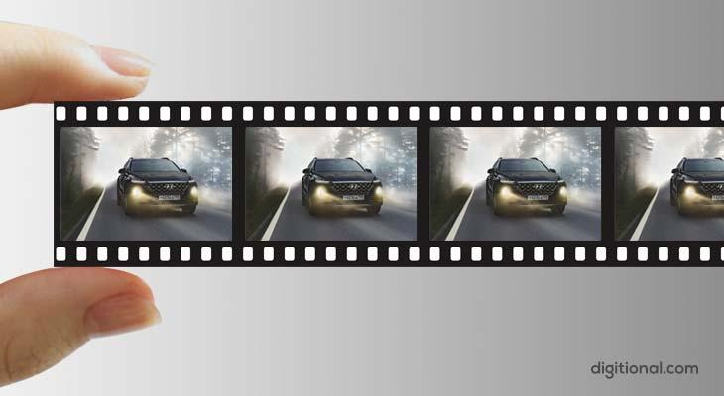
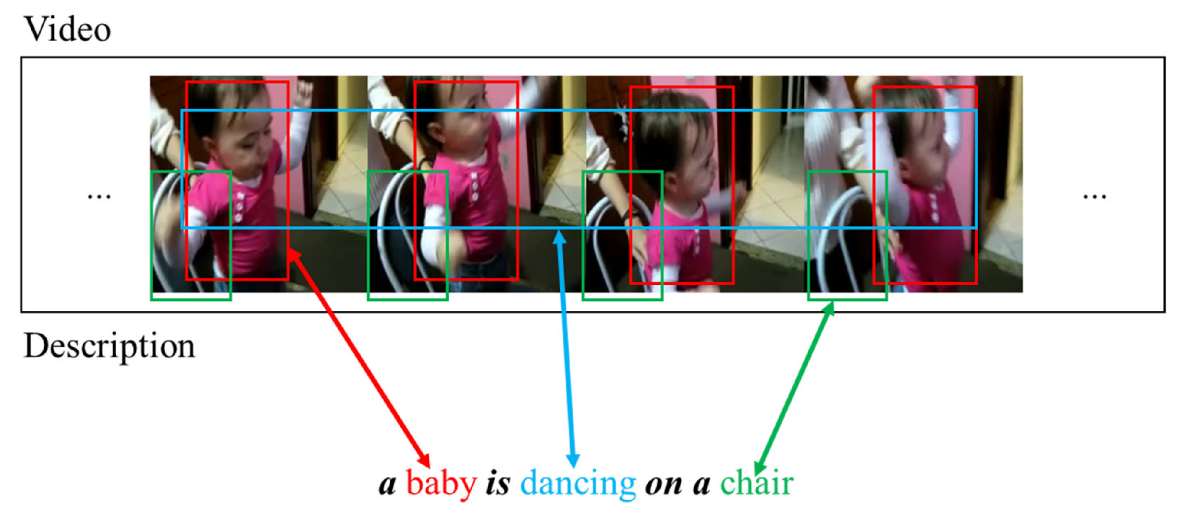


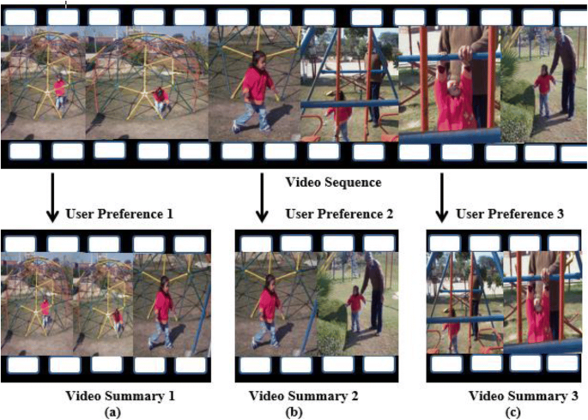
OUR APPROACH

Slide 5
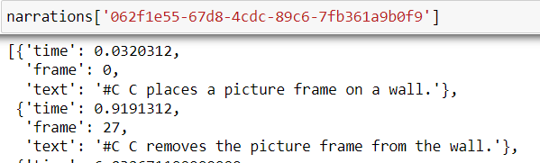
DATASET
ego4D dataset
limited the use case to cleaning and laundry videos
44 videos of varying lengths (3 to 30 minutes)
The data contains the description of frames, frame number and time stamp along with the video

Slide 6
DATA PREPROCESSING
Video is broken down into frames.
Each frame is resized to 224, 224 and normalized by 255.
Those frames which have descriptions available in ego4D dataset, were converted to numpy arrays and Images.
All such frames and their respective descriptions were transformed into hugging face dataset format.
Out of 44 videos, we got 6500 images, 5200 were selected for training, and 1040 and 260 were set out for testing and validation.

Slide 7
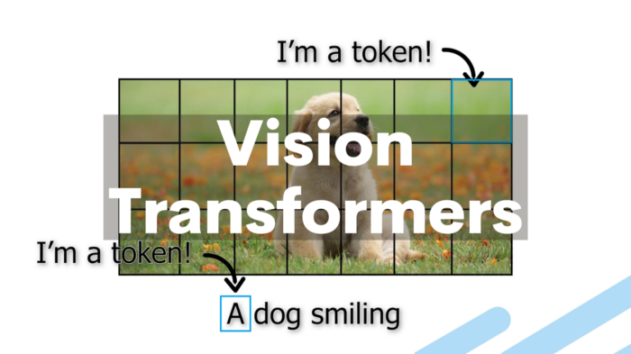


IMAGE CAPTIONING MODEL
Image Captioning is done by combining ViT and GPT-2.
Vision Transformer is used as encoder for image encoding Feature extraction of the images is also done using ViT’s feature extractor.
GPT-2 is used as a decoder to decode the image embeddings into Natural Language. GPT’s tokenizer is used for the same task.

Slide 8
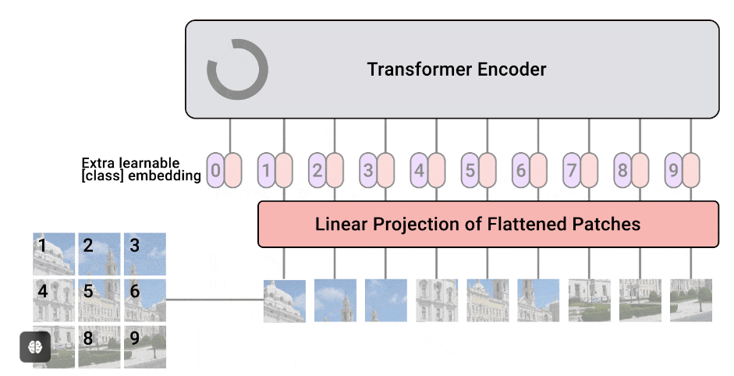
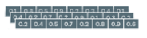
IMAGE CAPTIONING MODEL
VISION TRANSFORMER AS ENCODER
Image embeddings

Slide 9
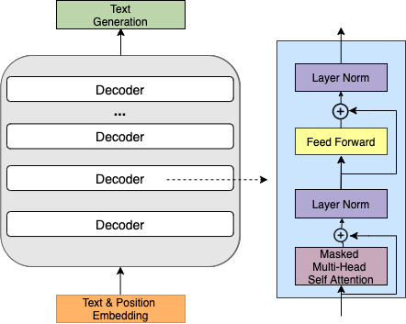
IMAGE CAPTIONING MODEL
Image captions
GPT-2 AS DECODER
Image embeddings

Slide 10

IMAGE CAPTIONING MODEL
Fine-tuning:
We have fine-tuned this model on Ego4D (Cleaning & Laundry) dataset.
During training we have used Rouge metric for evaluation of predicted captions.

Slide 11
IMAGE CAPTIONING MODEL
Testing:
After fine-tuning we have tested our model on test images by predicting the captions and then calculating Bleu Score of predicted & actual captions of test images.
On 206 testing images 0.512 bleu score was achieved.

Slide 12
FILTERING WITH QUERY
Captions for every 15th frame will be generated using our trained model.
LLAMA INDEX is used for storing these captions.
A user query will retrieve the frames similar to the input query.
For every similar frame, preceding and succeeding 4 seconds are selected to be included in the summary. This is done to maintain cohesiveness between the frames.

Slide 13
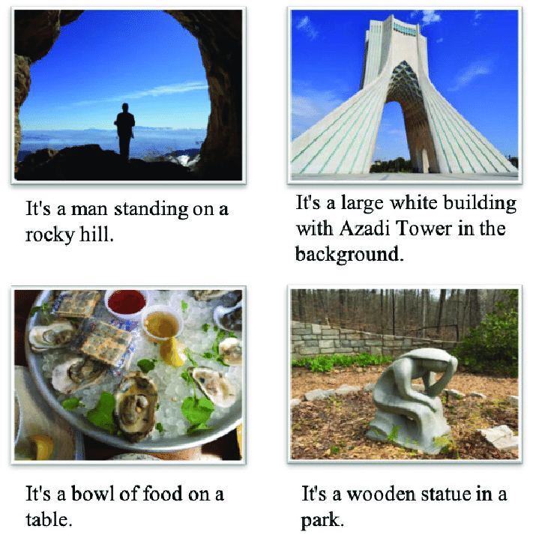


FILTERING WITH QUERY

Slide 14
EVALUATION METRICS
F1-score and recall are the common evaluation metrics used for video summarization tasks. True positive, false positive and false negatives, in this case, would be
True Positives = Frames in both ground truth and machine summary
False Positives = Frames in machine summary but not in ground truth
False Negatives = Frames in ground truth but not in machine summary

Slide 15
RESULTS
Compared to baseline results on ego4D dataset which is a recall of 44.80, we managed to outperform these results by 13%.
S.No | F1-Score | Recall
1. | 41.74 | 54.64
2. | 71.34 | 70.50
3. | 19.79 | 35.02
4. | 60.06 | 75.17
5. | 45.74 | 51.48
 | 47.73 | 57.36

Slide 16
OUR CONTRIBUTION
Previous methods of video summarization revolved around building the own architecture and training on the dataset. This method is resource and computational intensive.
We leveraged pre trained huge models like ViT and GPT-2 to summarize videos for us.
Moreover there does not exist any methods which retrieve similar frames using similarity based on Natural Language.

Slide 17
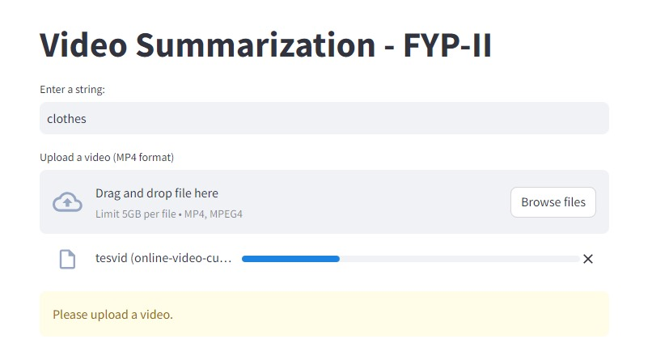
GRAPHICAL USER INTERFACE

Slide 18
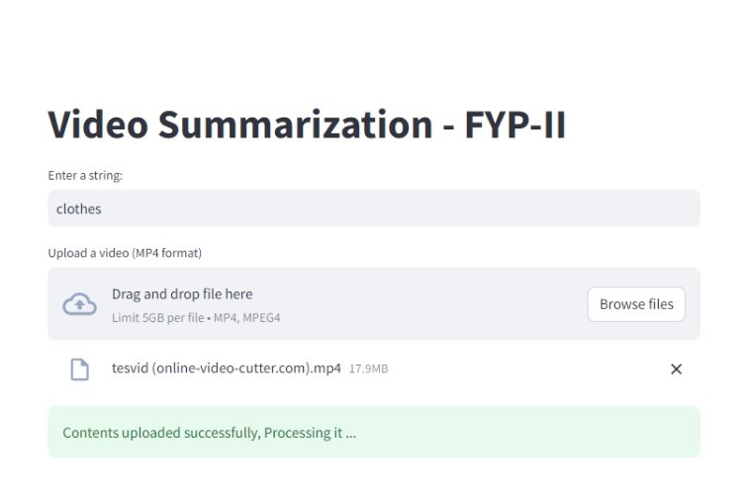

Slide 19
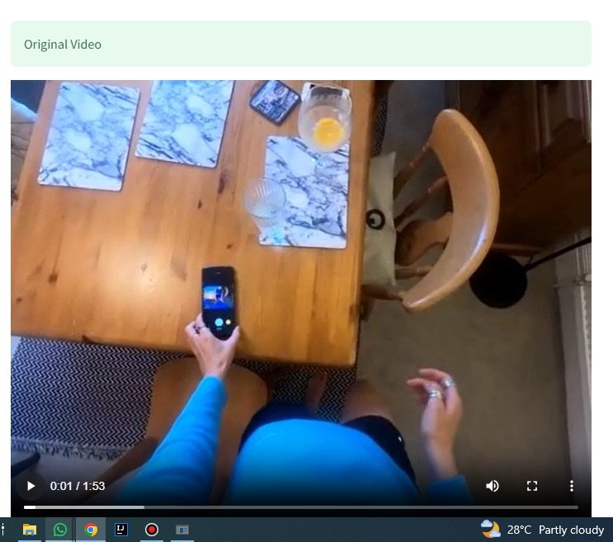

Slide 20
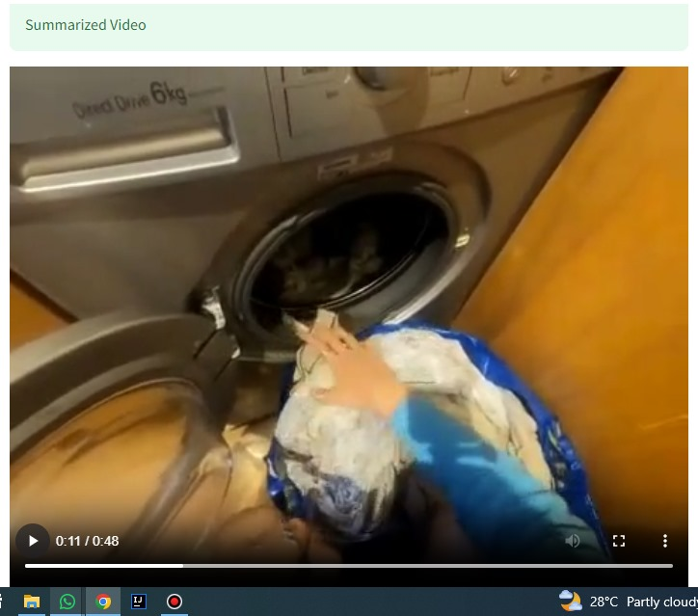

Slide 21
CONCLUSION
Our project focused on query-based video summarization. We fine-tuned the ViT (Vision Transformer) model for feature extraction from images and used GPT-2 as the language model decoder. By leveraging the Llama index, we retrieved relevant captions based on user queries. The result is accurate, personalized video summaries.

Slide 22
FUTURE WORK
We finetuned ViT and GPT to provide frame level descriptions. Using CLIP instead of ViT and GPT would yield better results because CLIP is trained on a large number of images.
We have trained only on cleaning and laundry videos. Incorporation of further categories will encompass broader aspects of videos.

Slide 23
RELATED WORK
CLIP-It! Language-Guided Video Summarization
https://arxiv.org/pdf/2107.00650v2
Query Controllable Video Summarization https://arxiv.org/pdf/2004.03661v1.pdf
Query-Focused Video Summarization: Dataset, Evaluation, and A Memory Network Based Approach https://arxiv.org/pdf/1707.04960.pdf

Slide 24
THANKS FOR LISTENING ☺
We are open to questions now

